Slide 1
An Overview of C
Part-1

Slide 2
What is C?
  A programming language written by Dennis Ritchie at AT&T Labs of USA in 1972.
  Originally created to design and support the Unix operating system.

Slide 3
Why use C?
Mainly because it produces code that runs nearly as fast as code written in assembly language. Some examples of the use of C might be:
  Operating Systems
  Language Compilers
  Assemblers
  Text Editors
This is used mainly because of the portability that writing standard C programs can offer.
Major parts of popular operating systems like Windows, UNIX, Linux are still written in C.

Slide 4
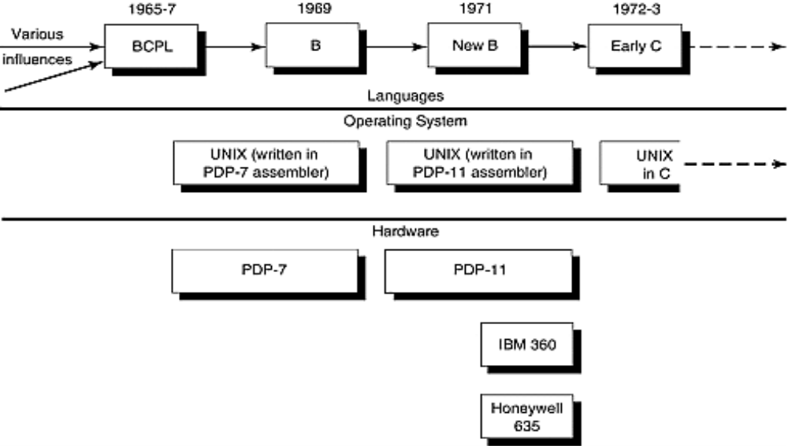
History
Early C, UNIX, and Associated Hardware

Slide 5
Why C – Middle level language ?
  Relatively good programming efficiency (as compared to machine oriented languages)
  Relatively good machine efficiency (as compared to high level languages)
  Gateway for other professional languages like C → C++ → Java

Slide 6
Feature of C
Hardware independent
Programs portable to most computers
Provide functionality through rich set of function libraries
Case-sensitive

Slide 7
STARTING WITH PROGRAMMING.

Slide 8
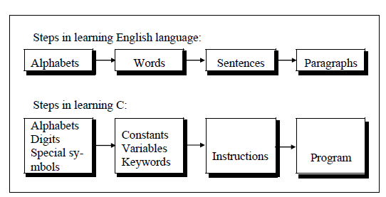
A close analogy between learning English language and learning C language.

Slide 9
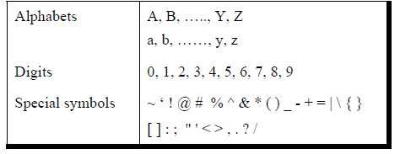
C CHARACTER SETS
The alphabets, numbers and special symbols when properly combined form constants, variables and keywords.

Slide 10
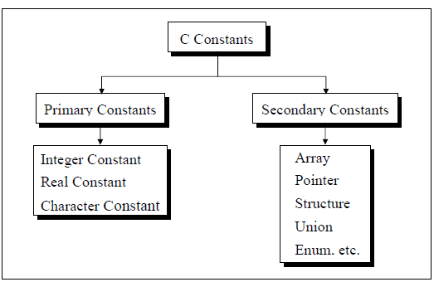
DATA TYPES
A data type defines a set of values and a set of operations that can be applied on those values.
For example, a light switch can be compared to a computer type. It has a set of two values, on and off. Only two operations can be applied to a light switch: turn-on and turn-off.
C Data types
Data types
Data types
Character
Integer
Float
Double
Void

Slide 11
PRIMARY DATA TYPES
char (1 byte) – any character belonging to C character set.
int (2 bytes) – positive or negative integers.
float (4bytes) – single precision floating point (real) number.
double (8 bytes) – floating point value with great exactness.
void (0 bytes) – specify empty set of values.
Secondary data types can be derived from these Primary data types.

Slide 12
C CONSTANTS
A constant is a quantity that doesn’t change.
This quantity can be stored at a location in the memory of the computer.
Commonly used Constants :
character, integer, float, logical and string

Slide 13
Rules for Constructing Integer Constants
An integer constant must have at least one digit.
It must not have a decimal point.
It can be either positive or negative.
No commas or blanks are allowed within an integer constant.
Assumed to be positive, if no sign precedes an integer constant.
The allowable range for integer constants is -32768 to 32767.(16-bit computers)

Slide 14
Real Constants
Real constants are often called Floating Point constants.
The real constants could be written in two forms—
Fractional form and Exponential form.

Slide 15
Rules for Constructing Real Constants
expressed in Fractional form:
A real constant must have at least one digit.
It must have a decimal point.
It could be either positive or negative, default sign is positive.
No commas or blanks are allowed within a real constant.
Ex.+325.34, 423.0, -34.6754

Slide 16
Rules for Constructing Real Constants expressed in Exponential form:
The mantissa part and exponential part should be separated by a letter e.
The mantissa part may have a positive or negative sign, default sign is positive.
The exponent must have at least one digit which must be a positive or a negative integer, default sign is positive.
Range of real constants expressed in exponential form is -3.4e38 to 3.4e38.
Ex.+3.2e-5, 4.1e8, -0.7e-5

Slide 17
Rules for Constructing Character Constants
A character constant is a single alphabet, a single digit or a single special symbol enclosed within single inverted commas.
Both the inverted commas should point to the left. For example, ’A’ is a valid character constant whereas ‘A’ is not.
The maximum length of a character constant can be 1 character.
The valid range of a character constant is -128 to 127. eg. ASCII value of ’A’ is 65
Ex.: 'A' , 'I' , '5' ,'='

Slide 18
Some Character Constants and their Integer Values
character: 'a' 'b' 'c' ... 'z'
integer value: 97 98 99 ... 112
character: 'A' 'B' 'C' ... 'Z'
integer value: 65 66 67 ... 90
character: '0' '1' '2' ... '9'
integer value: 48 49 50 ... 57
character: '&' '*' '+'
integer value: 38 42 43
The character ‘0‘ has a value of 48

Slide 19
Character Constants
‘c’ , a single character in single quotes are stored as char.
Some special characters are represented as two characters in single quotes.
‘\n’ = newline,
‘\t’ = tab
‘\\’ = backlash
‘\”’ = double quotes.

Slide 20
Logical Constant
Can take either of two values: truth or falsity.
Non zero value is treated as truth.
Zero is treated as falsity.
Eg. 32, -45, 4.5 treated as constants having a truth value, 0 as a false value.

Slide 21
String Constant
Collection of characters enclosed within a pair of double inverted commas
Ex. “Hello”, “123, Sector-9”, “123.56”
Each string constant ends with a special character ’\0’, string terminator

Slide 22
ASCII
Special control characters
| 0 NUL| 1 SOH| 2 STX| 3 ETX| 4 EOT| 5 ENQ| 6 ACK| 7 BEL|
| 8 BS | 9 HT | 10 NL | 11 VT | 12 NP | 13 CR | 14 SO | 15 SI |
| 16 DLE| 17 DC1| 18 DC2| 19 DC3| 20 DC4| 21 NAK| 22 SYN| 23 ETB|
| 24 CAN| 25 EM | 26 SUB| 27 ESC| 28 FS | 29 GS | 30 RS | 31 US |
| 32 SP | 33 ! | 34 " | 35 # | 36 $ | 37 % | 38 & | 39 ' |
| 40 ( | 41 ) | 42 * | 43 + | 44 , | 45 - | 46 . | 47 / |
| 48 0 | 49 1 | 50 2 | 51 3 | 52 4 | 53 5 | 54 6 | 55 7 |
| 56 8 | 57 9 | 58 : | 59 ; | 60 < | 61 = | 62 > | 63 ? |
| 64 @ | 65 A | 66 B | 67 C | 68 D | 69 E | 70 F | 71 G |
| 72 H | 73 I | 74 J | 75 K | 76 L | 77 M | 78 N | 79 O |
| 80 P | 81 Q | 82 R | 83 S | 84 T | 85 U | 86 V | 87 W |
| 88 X | 89 Y | 90 Z | 91 [ | 92 \ | 93 ] | 94 ^ | 95 _ |
| 96 ` | 97 a | 98 b | 99 c |100 d |101 e |102 f |103 g |
|104 h |105 i |106 j |107 k |108 l |109 m |110 n |111 o |
|112 p |113 q |114 r |115 s |116 t |117 u |118 v |119 w |
|120 x |121 y |122 z |123 { |124 | |125 } |126 ~ |127 DEL|

Slide 23
Basic Data Types
Integral Types
  char Stored as 8 bits. Unsigned 0 to 255.
  Signed -128 to 127.
  short int Stored as 16 bits. Unsigned 0 to 65535.
  Signed -32768 to 32767.
  int Same as either short or long int.
  long int Stored as 32 bits.
  Unsigned 0 to 4294967295.
  Signed -2147483648 to 2147483647
Notes:
C guarantees only following:
Sizeof(short) <= sizeof(int) <= sizeof(long).

Slide 24
Basic Data Types
Floating Point Numbers
  Floating point numbers are rational numbers. Always signed numbers.
  float Approximate precision of 6 decimal digits .
    Typically stored in 4 bytes with 24 bits of signed mantissa and 8 bits of signed exponent.
  double Approximate precision of 14 decimal digits.
    Typically stored in 8 bytes with 56 bits of signed mantissa and 8 bits of signed exponent.

Slide 25
Constants
Numerical Constants
  Constants like 12, 253 are stored as int type. No decimal point.
  12L or 12l are stored as long int.
  12U or 12u are stored as unsigned int.
  12UL or 12ul are stored as unsigned long int.
  Numbers with a decimal point (12.34) are stored as double.
  Numbers with exponent (12e-3 = 12 x 10⁻³ ) are stored as double.
  12.34f or 1.234e1f are stored as float.
  These are not valid constants:
  25,000 7.1e 4 $200 2.3e-3.4 etc.

Slide 26
VARIABLES
Variable is a quantity that may vary during program execution.
Variable names are names given to locations in memory, where a constant is stored.
      Ex int a=3;
These locations can contain integer, real or character constants.
A particular type of variable name can hold only that type of constant.
Eg. An integer variable can hold only an integer constant, a real variable can hold only a real constant and a character variable can hold only a character constant.
a
3

Slide 27
Rules for Constructing Variables Names
A variable name is any combination of 1 to 8 alphabets, digits and underscores (some compilers allow upto 40 characters)
The first character must be an alphabet letter or an underscore (system variable).
No commas and blanks are allowed within a variable name.
Case matters!
C keywords cannot be be used as variable names.
Examples:
present, hello, y2x3, r2d3, ... /* OK */
_1993_tar_return /* OK but don’t use it*/
Hello#there /* illegal */
double /* shouldn’t work */
2fartogo /* illegal */

Slide 28
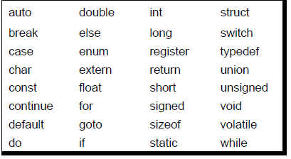
KEYWORDS
Keywords are the words whose meaning has already been explained to the C compiler (or in a broad sense to the computer).
The keywords cannot be used as variable names.
The keywords are also called ‘Reserved words’.
There are only 32 keywords available in C.

Slide 29
CLASS EXERCISE
Which of the following are invalid variable names and why?
2006
FLOAT
2015_DDay
int

Slide 30
Memory concepts
Every variable has a name, type and value
Variable names correspond to locations in computer memory
New value over-writes the previous value– “Destructive read-in”
Value reading called “Non-destructive read-out”

Slide 31
Basic Datatypes
There are only a few basic data types in C
    char
    int
    float
    double
  All types have a fixed size associated with them
DATA Bytes Required
The letter x (char) 1
The number 100(int) 2
The number 12.14 (float) 4

Slide 32
Variable Declaration
Generic Form
    <typename> <varname1>, <varname2>, ... ;
Examples:
    int count;
    float a;
    double percent, total;
    char p;
Initialization
Examples:
    int count; /* Set aside storage space for count */
    count = 0; /* Store 0 in count */
This can be done at definition also:
    int count = 0;
    double percent = 10.0, rate = 0.56;

Slide 33
  You can also declare variables as being constants
  Use the const qualifier:
    const double pi=3.1415926;
    const int maxlength=2356;
    const int val=(3*7+6)*5;
    We cannot change the value of constant variable during the program.

Slide 34
EXERCISE☺
A character variable can at a time store
(1) 1 character
(2) 8 characters
(3) 254 characters
(4) None of the above
The statement char ch = ‘Z’ would store in ch
(1) The character Z
(2) ASCII value of Z
(3) Z along with the single inverted commas
(4) Both (1) and (2)
Which of the following is NOT a character constant
(1) ‘Thank You’
(2) ‘Enter values of P, N, R’
(3) ‘23.56E-03’
(4) All the above

Slide 35
Arithmetic operators in C
C operation Algebric C
Addition(+) a+7 a+7
Subtraction (-) b-c b-c
Multiplication(*) am a*m
Division(/) x/y x/y
Modulus(%) r mod s r%s
An expression is a combination of variables, constants and operators.

Slide 36
Precedence order
Highest to lowest (left to right in an expression)
    ( )
    *, /, %
    +, -
Example:
z = p * r % q + w / x – y ;
1 2 4 3 5
a * ( b + c ) + c * ( d + e ) ;
3 1 5 4 2

Slide 37
YOUR TURN ☺
(a) C language has been developed by
  (1) Ken Thompson
  (2) Dennis Ritchie
  (3) Peter Norton
  (4) Martin Richards
(b) C can be used on
  (1) Only MS-DOS operating system
  (2) Only Linux operating system
  (3) Only Windows operating system
  (4) All the above
(c) C programs are converted into machine language with the help of
  (1) An Editor
  (2) A compiler
  (3) An operating system
  (4) None of the above
(d) The real constant in C can be expressed in which of the following forms
  (1) Fractional form only
  (2) Exponential form only
  (3) ASCII form only
  (4) Both fractional and exponential forms

Slide 38
YOUR TURN ☺
(e) The maximum value that an integer constant can have is
(1) -32767
(2) 32767
(3) 1.7014e+38
(4) –1.7014e+38
(f) A C variable cannot start with
(1) An alphabet
(2) A number
(3) A special symbol other than underscore
(4) Both (2) & (3) above
(g) Which of the following statement is wrong
(1) mes = 123.56 ;
(2) con = 'T' * 'A' ;
(3) this = 'T' * 20 ;
(4) 3 + a = b ;
(h) In b = 6.6 / a + 2 * n; which operation will be performed first?
(1) 6.6 / a
(2) a + 2
(3) 2 * n
(4) Depends upon compiler

Slide 39
Literals in C
Literals are representations of values of some types
  C allows literal values for integer, character, and floating point types
Integer literals
  Just write the integer in base 10
      int y=-46;
Character literals
  Character literals are specified with a single character in single quotes
      char ch='a';
  Special characters are specified with escape characters
Floating point literals
  Just write the floating point number
      float PI=3.14159;
  Can also use mantissa/exponent (scientific) notation
      double minusPItimes100 = -3.14159e2

Slide 40
Assignment Operator
x=3
  = is an operator
  The value of this expression is 3
  = operator has a side effect -- assign 3 to x
The assignment operator =
  The side-effect is to assign the value of the right hand side (RHS) to the left hand side (LHS).
  The value is the value of the RHS.
For example:
      x = ( y = 3 ) +1; /* y is assigned 3 */
      /* the value of (y=3) is 3 */
      /* x is assigned 4 */

Slide 41
Compound Assignment Operator
Often we use “update” forms of operators
  x=x+1, x=x*2, ...
C offers a short form for this:
  Generic Form : variable op= expr is equivalent to variable = variable op expr
Operator Equivalent to:
x *= y x = x * y
y -= z + 1 y = y - (z + 1)
a /= b a = a / b
x += y / 8 x = x + (y / 8)
y %= 3 y = y % 3
  Update forms have value equal to the final value of expr
    i.e., x=3; y= (x+=3); /* x and y both get value 6 */

Slide 42
TYPE CONFLICTS IN C
An arithmetic operation between an integer and integer always yields an integer result.
An operation between a real and real always yields a real result.
An operation between an integer and real always yields a real result. In this operation the integer is first promoted to a real and then the operation is performed. Hence the result is real.
.
Operation Result Operation Result
5 / 2 2 2 / 5 0
5.0 / 2 2.5 2.0 / 5 0.4
5 / 2.0 2.5 2 / 5.0 0.4
5.0 / 2.0 2.5 2.0 / 5.0 0.4

Slide 43
Type Conversion
C allows for conversions between the basic types,
  implicitly or
  explicitly.

Slide 44
Implicit Conversion
If the compiler expects one type at a position, but another type is provided, then implicit conversion occurs.
Conversion during assignments:
    char c='a';
    int i;
    i=c; /* i is assigned the ASCII code of ’a’ */
Arithmetic conversion – if two operands of a binary operator are not the same type, implicit conversion occurs:
    int i=5 , j=1;
    float x=1.0 , y;
    y = x / i; /* y = 1.0 / 5.0 */
    y = j / i; /* y = 1 / 5 so y = 0 */

Slide 45
Explicit Conversion
Explicit conversion uses the cast operator.
Example :
  int x=10;
  float y, z=3.14;
  y=(float) x; /* y=10.0 */
  x=(int) z; /* x=3 */
Example :
int i=5 , j=1;
float x=1.0 , y;
y = (float) j / i; /* y = 1.0 / 5 explicit*/
    /* The cast operator has a higher precedence */

Slide 46
Tokens
The smallest element in the C language is the token.
It may be a single character or a sequence of characters to form a single item.
Tokens can be:
  Numeric constants
  Character constants
  String constants
  Keywords
  Names (identifiers)
  Punctuation
  Operators
Manav Rachna College of Engg.

Slide 47
Simple C Program
A program to print “Welcome to c”
/* A first C Program*/
main()
{
printf(“Welcome to C\n");
}

Slide 48
void main()
This statement declares the main function.
A C program can contain many functions but must always have one main function.
A function is a self-contained module of code that can accomplish some task.

Slide 49
{
This opening bracket denotes the start of the program

Slide 50
printf("Welcome to C\n");
printf is a function from a standard C library that is used to print strings to the standard output, normally your screen.
The compiler links code from these standard libraries to the code you have written to produce the final executable.
The "\n" is a special format modifier that tells the printf to put a line feed at the end of the line.
If there were another printf in this program, its string would print on the next line.

Slide 51
}
This closing bracket denotes the end of the program.

Slide 52
Using Scanf() function-Input data
main ()
{
int num1,num2,sum;
  printf ("Enter two numbers\n");
  scanf ( "%d%d", &num1,&num2);
  sum=num1 + num2;
  printf ("\nSum = %d\n\n", sum);
}

Slide 53
Comments in C
Comments are used for documentation purpose
Two types of comments:
  Multi-line comment
/*---- comment ----*/
  Single Line comment //--comment

Slide 54
Using scanf() function-Input data with comments
main () //Main function
{
int num1,num2,sum; // Variable declaration
  printf ("Enter two numbers\n");
  scanf ( "%d %d", &num1,&num2); //Input data
  sum=num1 + num2; // Add two numbers
  printf ("\nSum = %d\n\n", sum); // Display sum
}

Slide 55
EXERCISE ☺
WAP to calculate square of a number.
WAP to calculate area of triangle.
WAP to calculate area of cylinder.
WAP to calculate average of two numbers.
WAP to swap two numbers using third variable.

Slide 56
Using scanf() function-Input data with comments
main () //Main function
{
int num1,num2,temp; // Variable declaration
  printf ("Enter two numbers\n");
  scanf ( "%d %d", &num1,&num2); //Input data
  temp=num1;
  num1=num2;
  num2=temp;
  printf ("\nAfter swapping, number1 = %d, Number 2 = %d \n", num1,num2);
}

